Slide 1
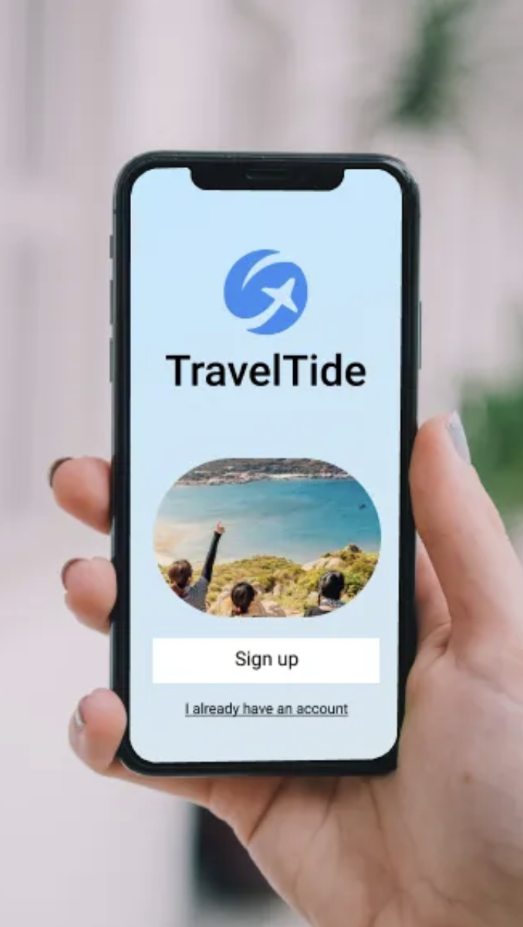
Know your Travelers
Personalized Rewards
to Strengthen Retention and Growth
Roberto Pera 2025/09/05

Slide 2
Setting the Stage
Q2 2021 - Q2 2023
~1 M
~5.5 M
~2.2 M
Users
Sessions
Bookings

Slide 3
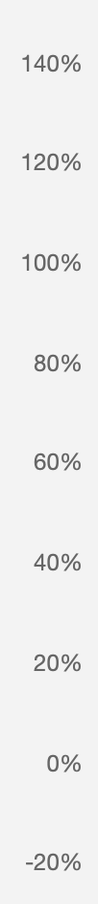
The User Growth Engine Is Stalling
Time To Pivot To Retention
2021 Q3
2021
Q4
2022
Q1
2022
Q2
2022
Q3
2022
Q4
2023
Q1
2023
Q2

Slide 4
From Data to Segmentation
1ST
2ND
3RD
4TH
Sessions
Users
Features
Segments

Slide 5
Business Travelers Dominate The Customer Base
But Retention Opportunities Span All Segments
1,289
945
835
754
544
539
446
430
Business Traveler
Leisure Explorer
Young
Escaper
Family
Bargain Seeker
Fresh Explorer
Window Shopper
Frequent Flyer

Slide 6
Personalized Perks For A Diverse Customer Base
Segment | Features (selected) | Perk
Business Traveler (~22%) | short weekday trips, minimal baggage | Priority Boarding
Leisure Explorer (~16%) | general leisure-oriented trips, no distinct or extreme behavioral patterns | Seasonal Promotions
Young Escaper (~14%) | under 30, short trips, budget | Last-minute Deals
Family (~13%) | group travel, bags, kids | Free Checked Bag
Bargain Seeker (~9%) | price-driven | Personalized Discount Alerts
Fresh Explorer (~9%) | just signed up (within last 28 days) | Welcome Voucher
Window Shopper (~8%) | no bookings | Wishlist & Price Alerts
Frequent Flyer (~7%) | highest booking-rate | Loyalty + Bundles

Slide 7
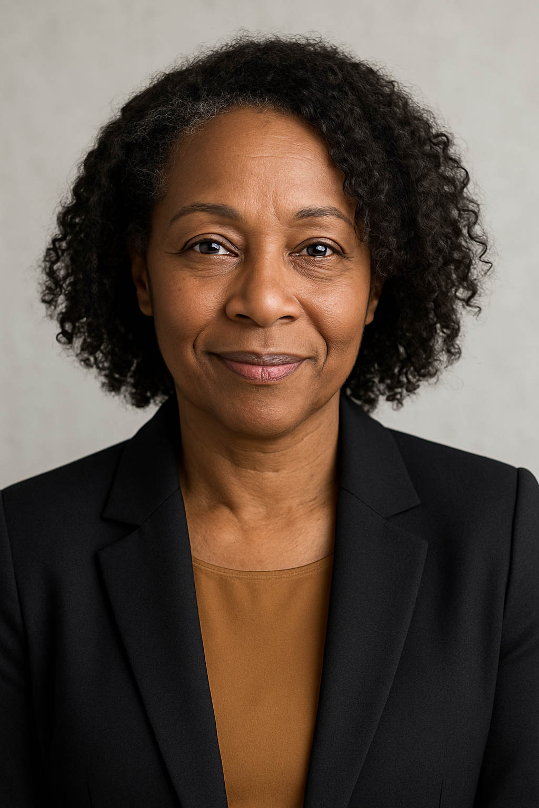
Who Are Our Customers?
Carol, 51 Business Traveler (~22%)
Job: Sales Manager
Behavior: Regular weekday trips, short stays, hand luggage only, fast booking with little browsing
Perk Fit: Priority Boarding
“I need to be in and out quickly. Time matters more than money.”
Personas and images are fictional and generated for illustrative purposes (images created with ChatGPT).

Slide 8

Who Are Our Customers?
Carlos, 40 - married, 2 kids Family (~13%)
Job: Teacher
Behavior: Multiple seats per booking, extra luggage, longer stays, school holiday travel
Perk Fit: Free Checked Bag
“Traveling with kids means extra bags and planning. Any support helps.”
Personas and images are fictional and generated for illustrative purposes (images created with ChatGPT).

Slide 9

Who Are Our Customers?
Amina, 23 Young Escaper (~14%)
Job: University Student
Behavior: Under 30, spontaneous weekend trips, budget hotels & flights, highly social-driven
Perk Fit: Youth-focused Last-Minute Deals
“I love spontaneous weekend getaways – if the price is right.”
Personas and images are fictional and generated for illustrative purposes (images created with ChatGPT).

Slide 10

Who Are Our Customers?
Jonas, 36 Window Shopper (~8%)
Job: Restaurant Owner
Behavior: Many sessions, zero bookings, heavy browsing, compares prices but doesn’t commit
Perk Fit: Wishlist & Price Alerts
“I like browsing trips, but I’m not ready to commit yet.”
Personas and images are fictional and generated for illustrative purposes (images created with ChatGPT).

Slide 11
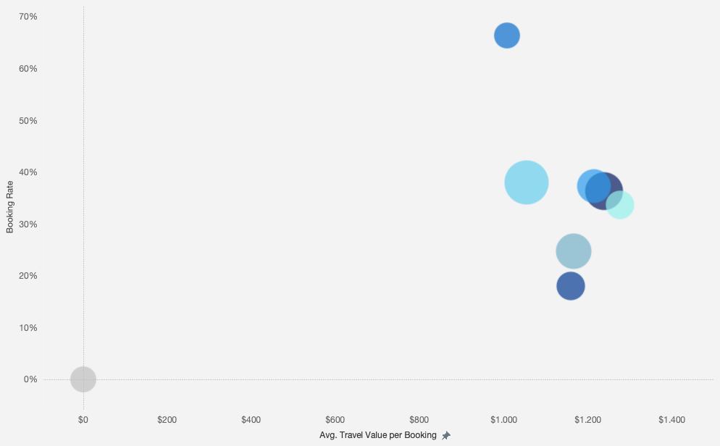
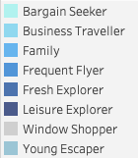
Where The Value Lies
Bubble Size by #Users

Slide 12
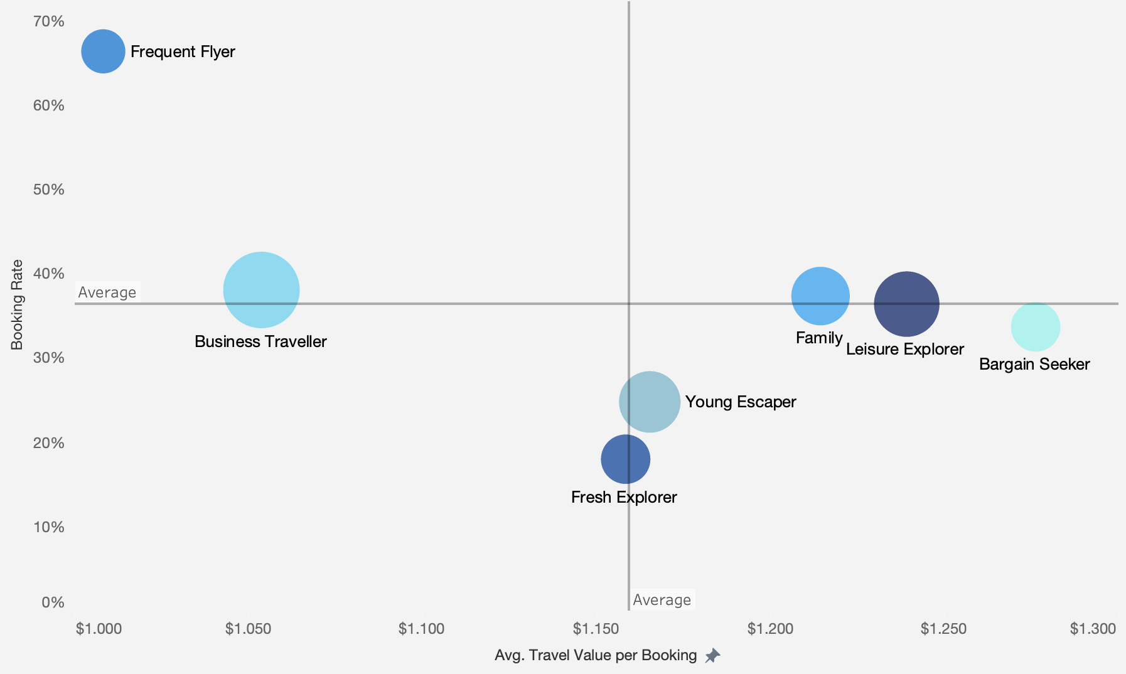
Where The Value Lies
Frequent Flyers
highest booking rate but below-average travel value
Family, Leisure Explorers, Bargain Seekers
jointly account for ~39% of the customer base
and deliver above-average travel value
Business Travellers
form a stable core
Fresh Escaper and Young Explorers
are avg. spend but under-converting segments

Slide 13
Recommendations
From Generic Rewards To Segment-Specific Impact
Solidify
the Core
Build on validated discount/baggage perks—refine by segment for maximum efficiency
Reposition "no cancellation fees" as priority boarding for time-sensitive business travelers
Unlock Growth Opportunities
Activate non-bookers: Wishlist & price alerts for Window Shoppers
Upsell loyal travelers: Loyalty extensions and cross-sell bundles for Frequent Flyers
Convert explorers: Welcome vouchers + last-minute deals for high-potential segments

Slide 14
Considerations & Next Steps
Considerations
Data Scope & Modeling Assumptions
Limited analysis based may not capture full seasonal patterns
Requires broader validation across customer base
Segment definitions reflect prioritization choices—reality may be more complex
Next Steps
Phase 1: Test & Validate
A/B test segment-specific perks vs. generic assignments
Establish retention KPIs and automated dashboards
Phase 2: Refine & Scale
Monitor performance, update segment weightings based on results
Integrate customer feedback loops and enhance personalization
Build scalable automation pipelines for perk distribution

Slide 15
Thank You

